Slide 1

BACHELOR OF SCIENCE IN MATHEMATICS
DEPARTMENT OF MATHEMATICS
GOVERNMENT ARTS AND SCIENCE COLLEGE
THENNANGUR-604408
OCTOBER 2023

Slide 2

ESTIMATION OF BUSINESS EXPENSES
TEAM LEADER :
P.PRIYA
TEAM MEMBERS:
S.MAGESH
M.VISHVA
P.DHANUSH KUMAR
OUR MENTOR:
MR. SUDHAGAR
DEPARTMENT OF MATHEMATICS

Slide 3

Estimation Of Business Expenses

Slide 4
Introduction:
Estimation Is A Key Technique For Pretending And Controlling Project Risks. Accurate Project Estimates To Aid In The Identification Of Cost And Schedule Requirements With Relative Precision ,Lowering The Danger Of Running Out Of Time , Resources , And Money During A Project .

Slide 5

Overview :
This Involves Estimating All The Expenses Required To Start And Operate The Business , Such As Equipment ,Rent , Inventory And Marketing . By Calculating There costs Upfront , Business Owner Can Better Plan Their Budget And Avoid Unexpected Expenses .

Slide 6

Purpose:
To Extract The Insights Some The Data And Put The Data In The Form Of Visualization , Dashboard And Story Employed Tableau Tools.

Slide 7
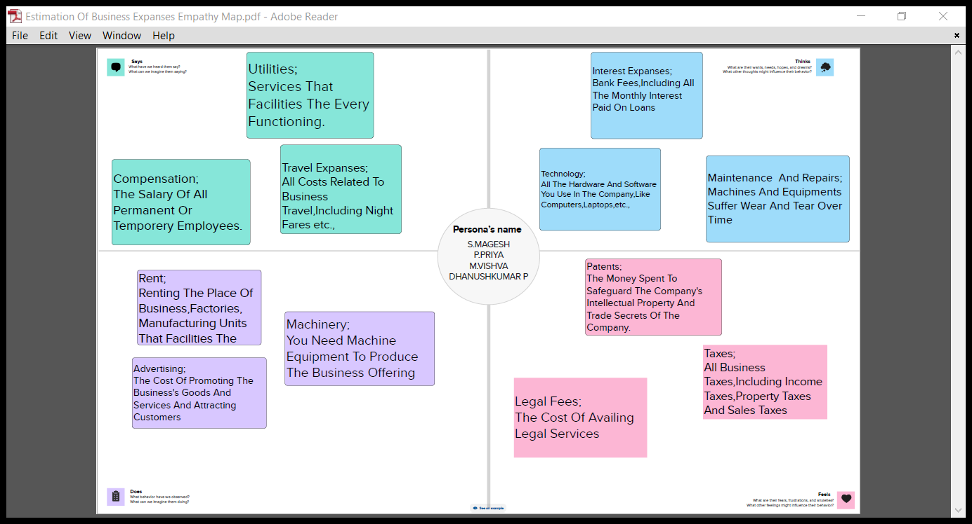

Slide 8
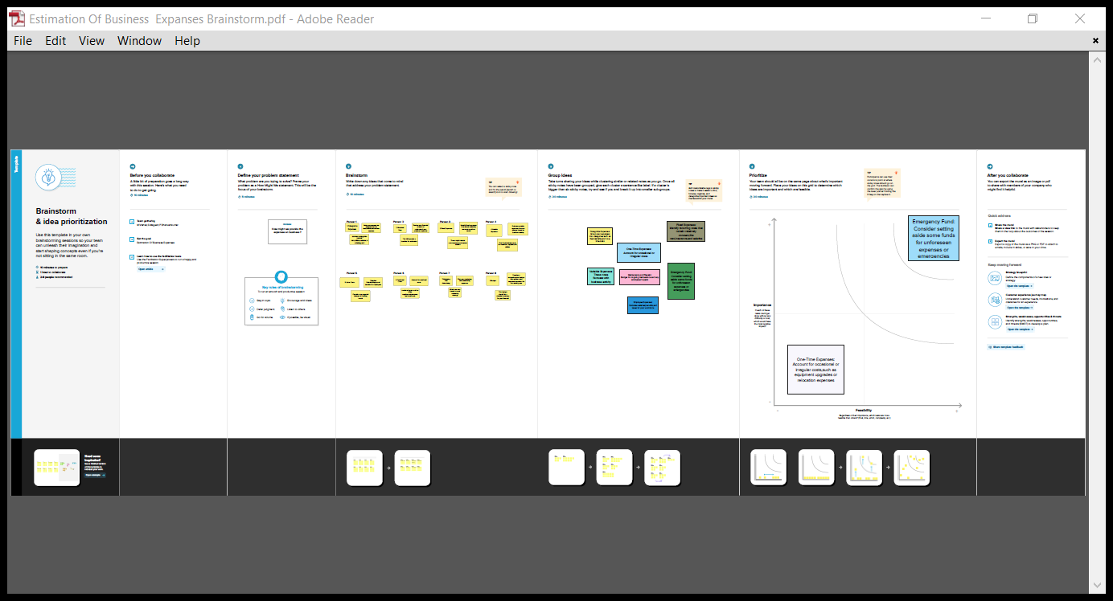

Slide 9
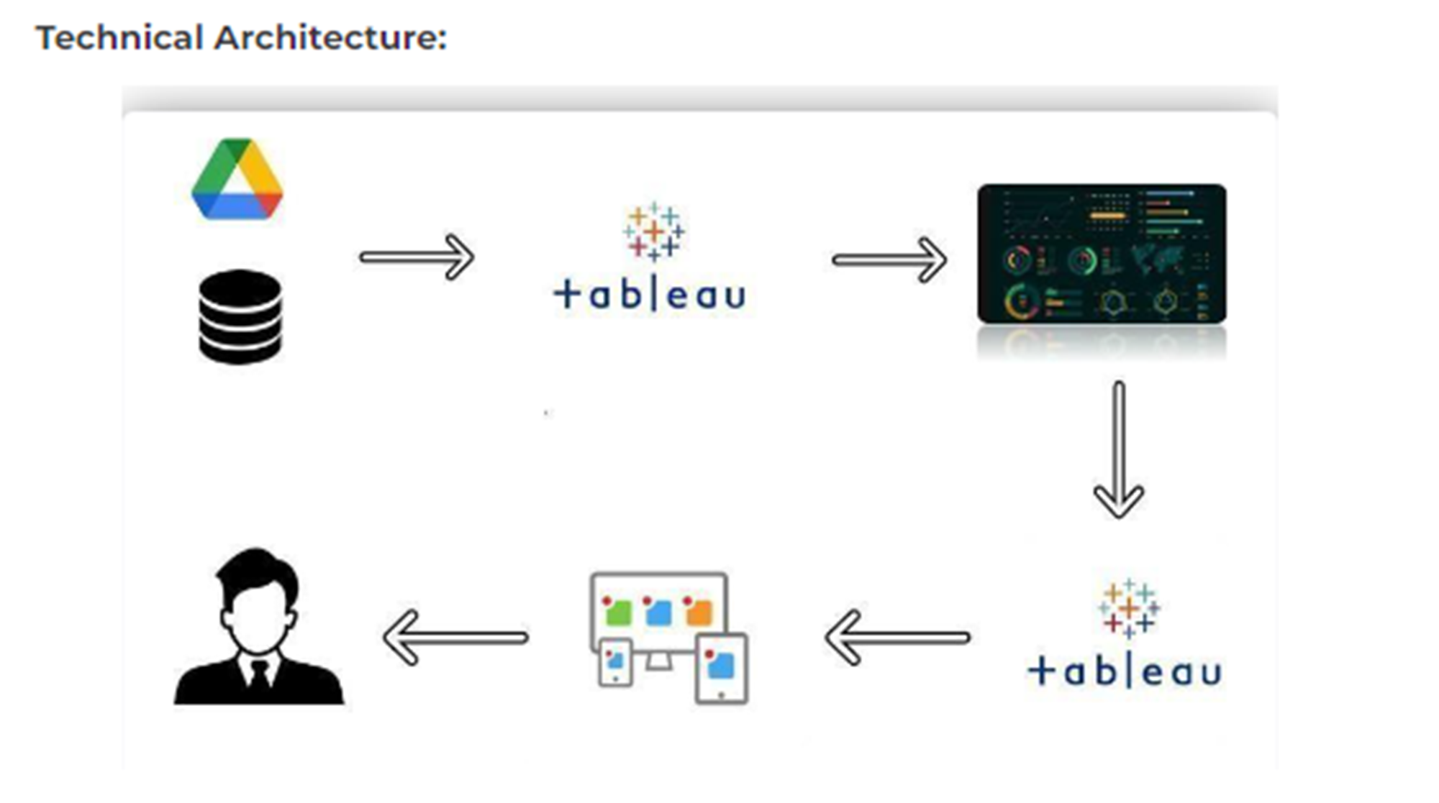

Slide 10
Visualizations

Slide 11
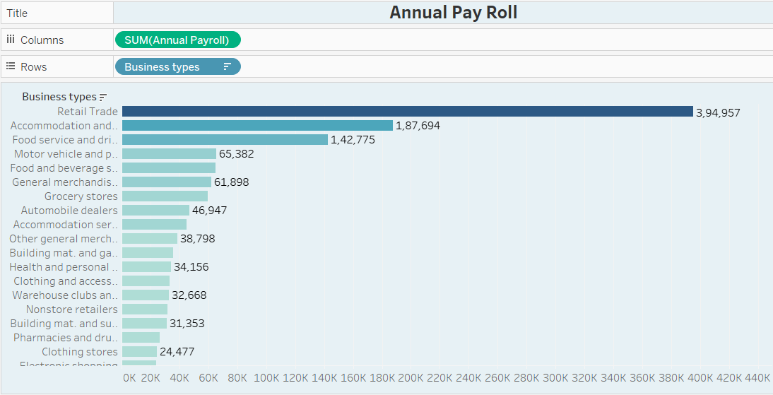

Slide 12
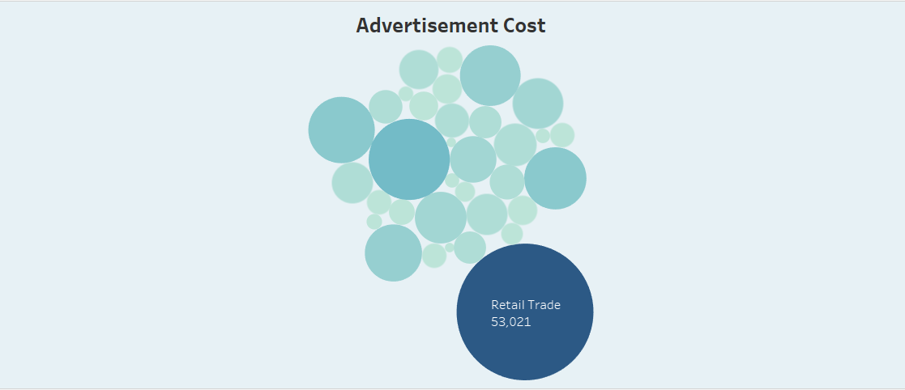

Slide 13
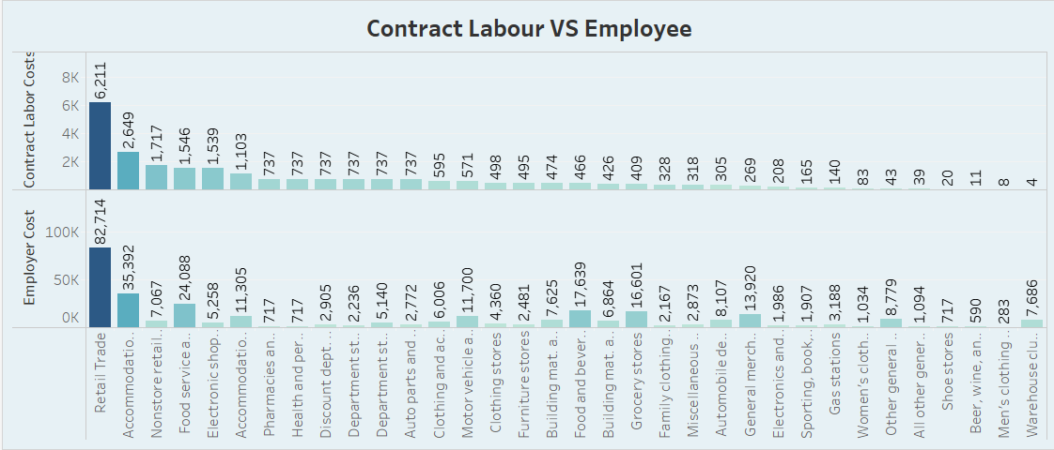

Slide 14
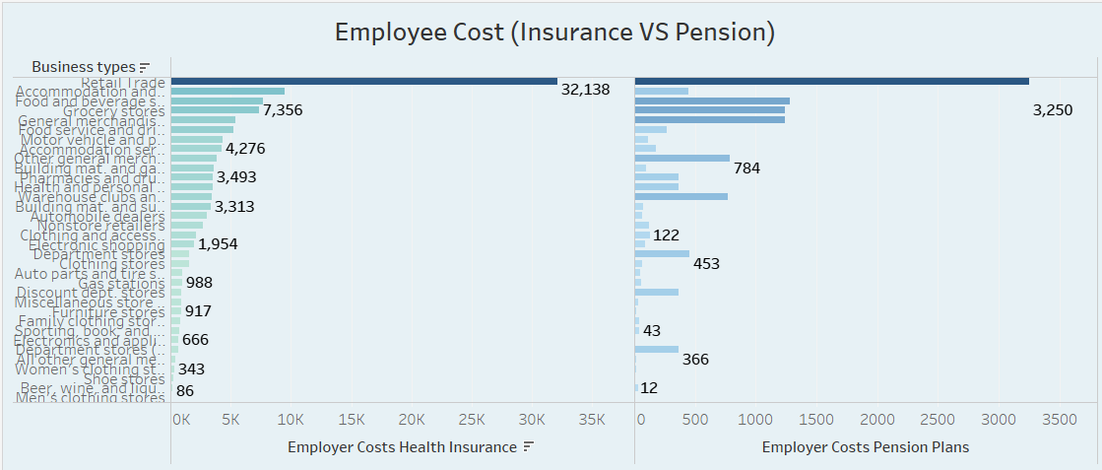

Slide 15
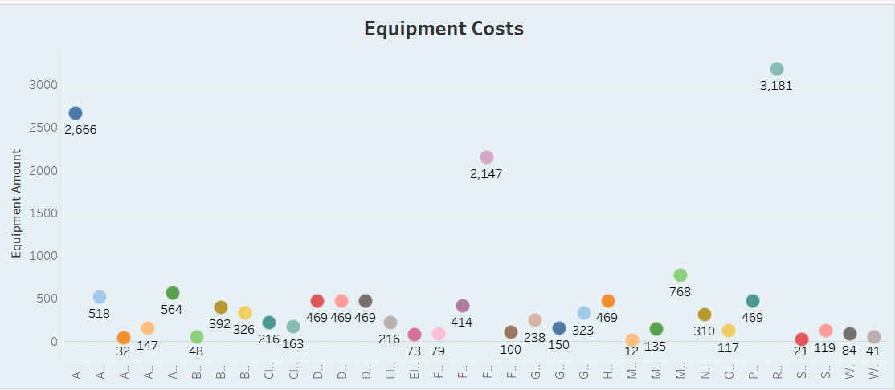

Slide 16
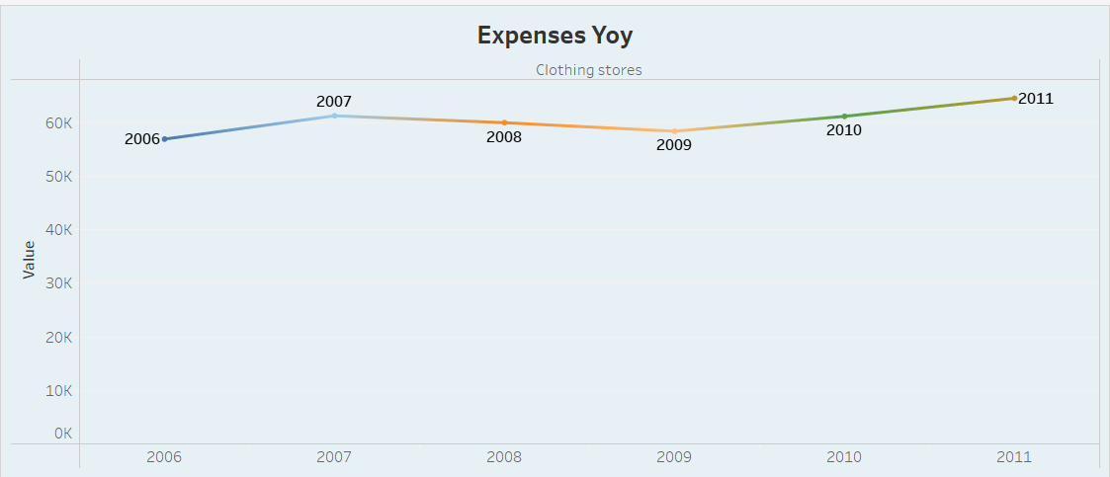

Slide 17
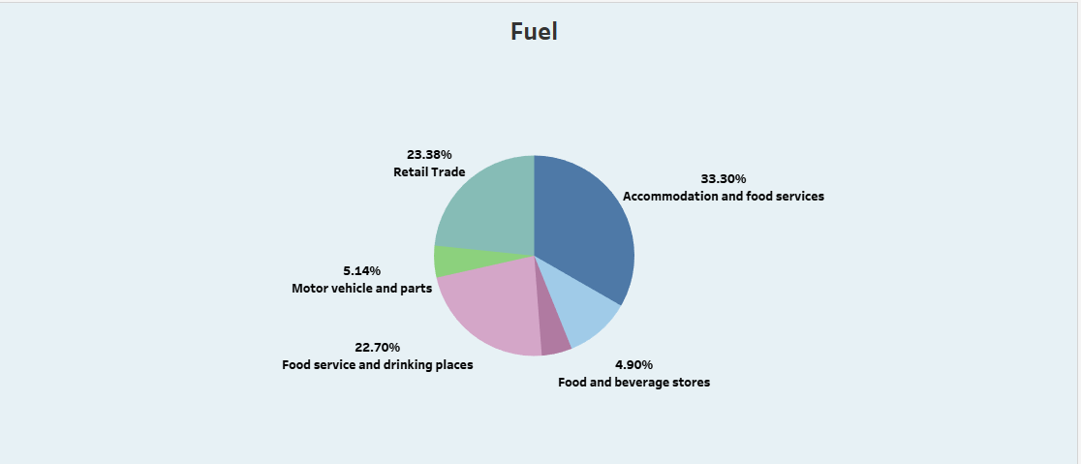

Slide 18
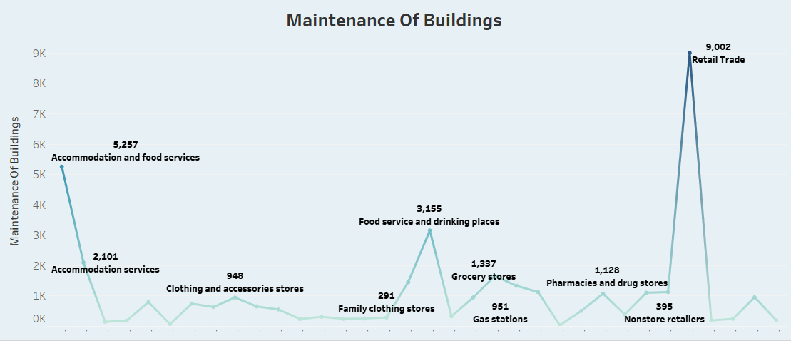

Slide 19
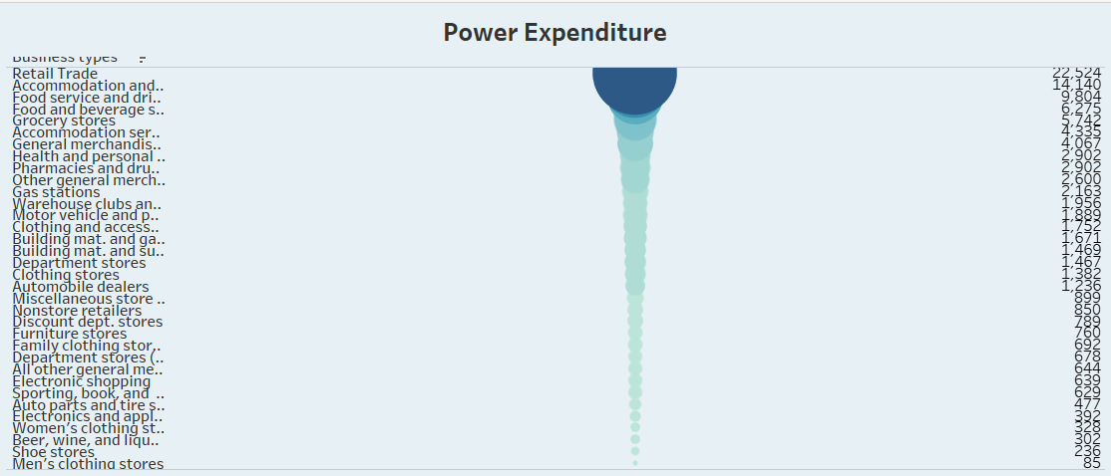

Slide 20
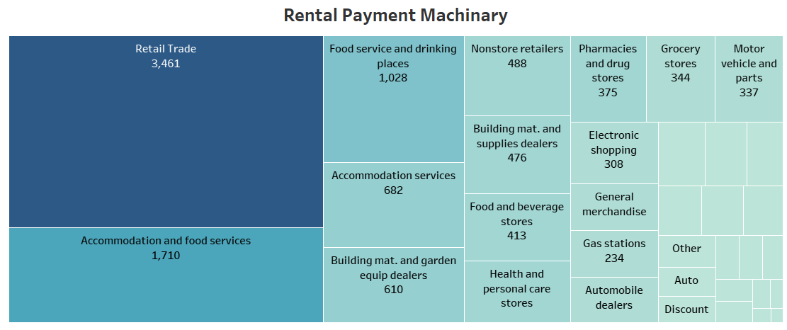

Slide 21
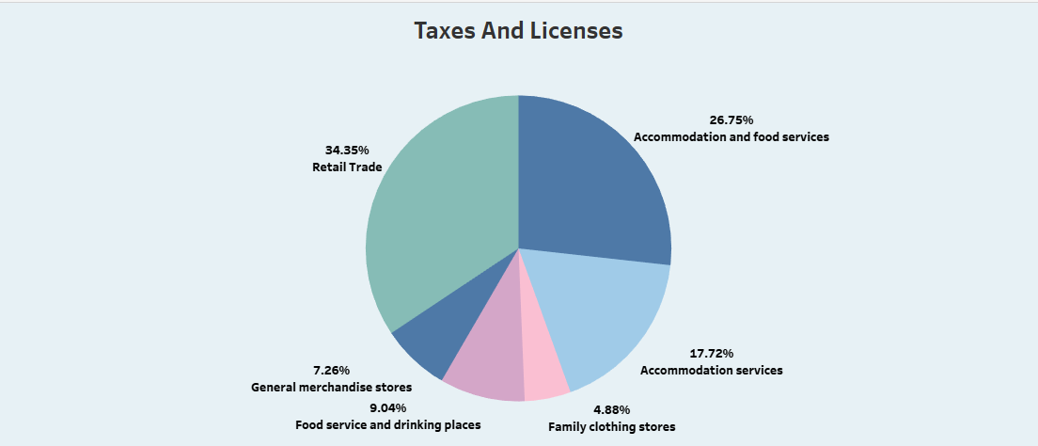

Slide 22
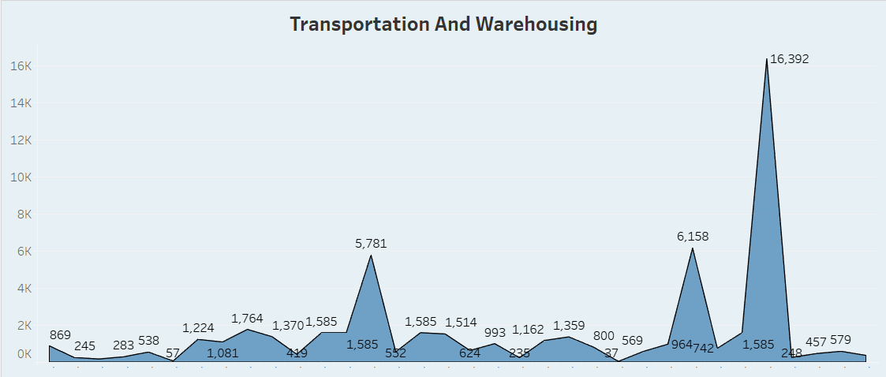

Slide 23

Dashboard

Slide 24
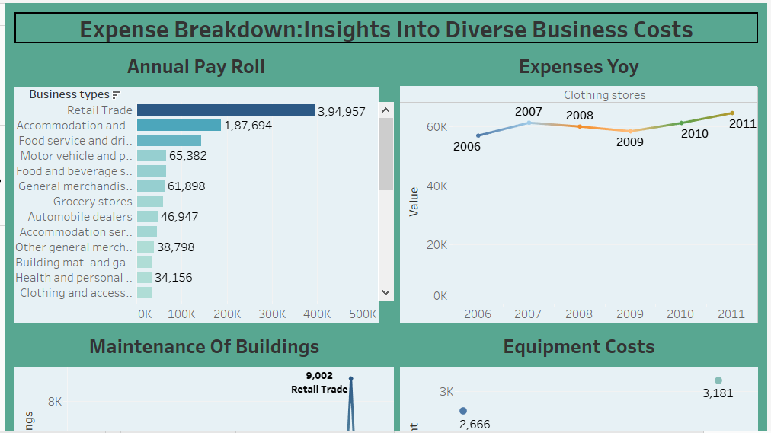

Slide 25
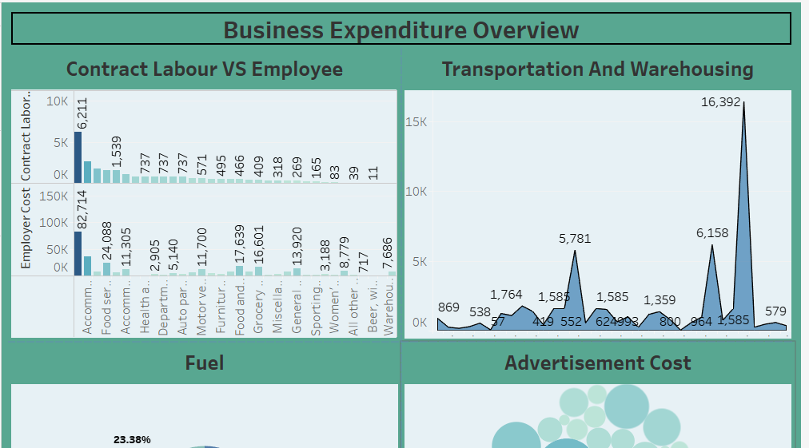

Slide 26
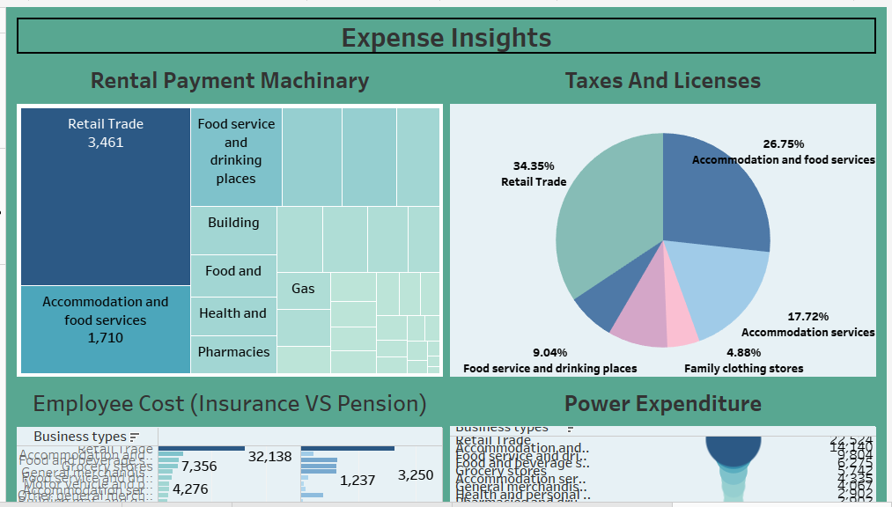

Slide 27

Story

Slide 28
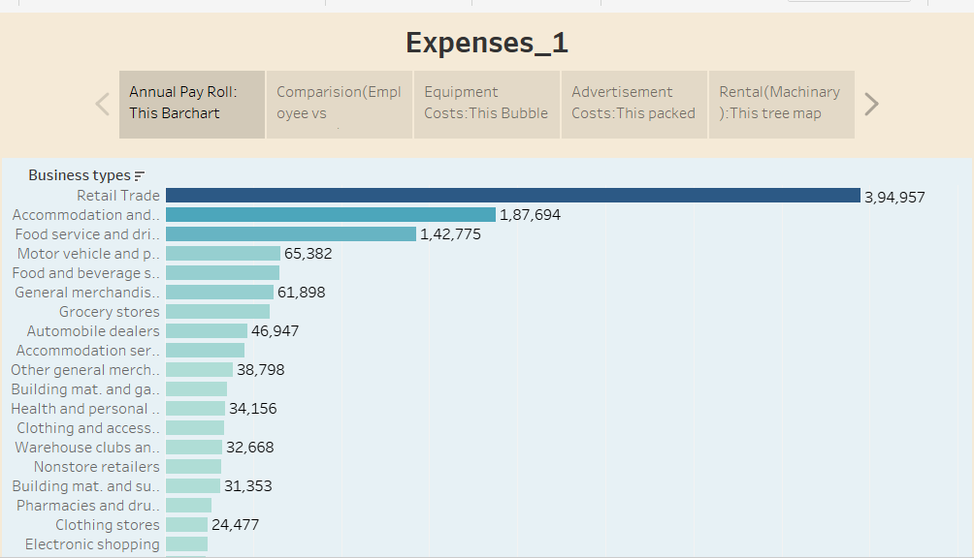

Slide 29
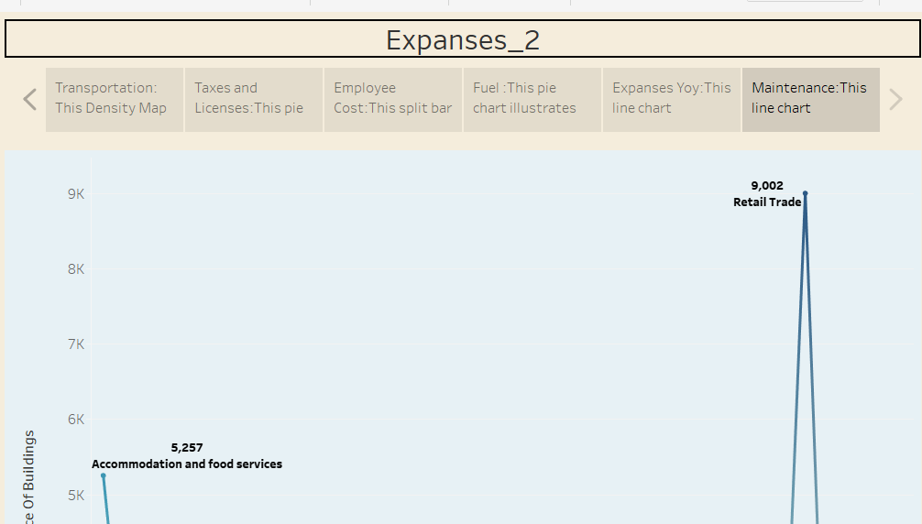

Slide 30
ADVANTAGES AND DISADANTAGES
ADVANTAGES:
DISADVANTAGES:
Flexible Areas And Calculations: Cost Estimation Models Interest Cost Some Use An Array Of Algorithm Models To Assign Values To Certain Factors In Order To Compute Costs Other Models Include An Expert Judgement Model And An Analogy Estimation .
Efficient And Cost Control : Efficiency Refers To The Ability To Do A Task Quickly And Accurately , To Saving The Business Both Time And Money . When The Right Type Of Model Is Chosen The Business Both Time And Money . When The Right Type Of Model Is Chosen The Business Can Realize Gains From Efficiency By Using Cost Estimation To Quickly Calculate Expenses And Make Choices On Funding Projects , Choosing Suppliers And Other Activities .
Subjectivity: Cost Estimation Is Somewhat Subjective Even With Algorithm Model , It Is Usually Up To The Business To Weight Certain Values Over Others And Assign The Correct Values To Factors .The Other Models Options Are Even More Subjective. This Means That Sometime Can Manager Makes Mistakes Just An Easily When Using A Cost Estimation Model Than When Working Without One.
Variable Factors: In A Perfect World , Factors Remain Steady And Cost Estimation Models Always Procedure Accurate Results . Unfortunately , Markets Are In Constant Flux, Prices Change And Technology .

Slide 31

Applications:
Tableau Can Be Used For Enable The Business To Function , Delivered Product Or Services And Pursue Growth Opportunity.

Slide 32

CONCLUSION:
In Business , An Estimate Is A Calculated Guess Of What Something Will Cost . Estimates Are Often Used In Bidding For Contracts Or Projects . They Can Also Be Used To Find Out How Much Material Or Labour Is Needed For A Job .

Slide 33

Future Scope:
The Future Scope Of The Business Expense Are Understanding The Different Types Of Business Is Essential. It Defines The Physical Boundaries Within Which A Company Contact Its Operation. It Encompasses Every From Customer Demographics And Psychographics To Purchasing Behaviours And Needs.

Slide 34

Thank You

